Slide 1
Data Analysis and Insights for different page Optimization

Slide 2
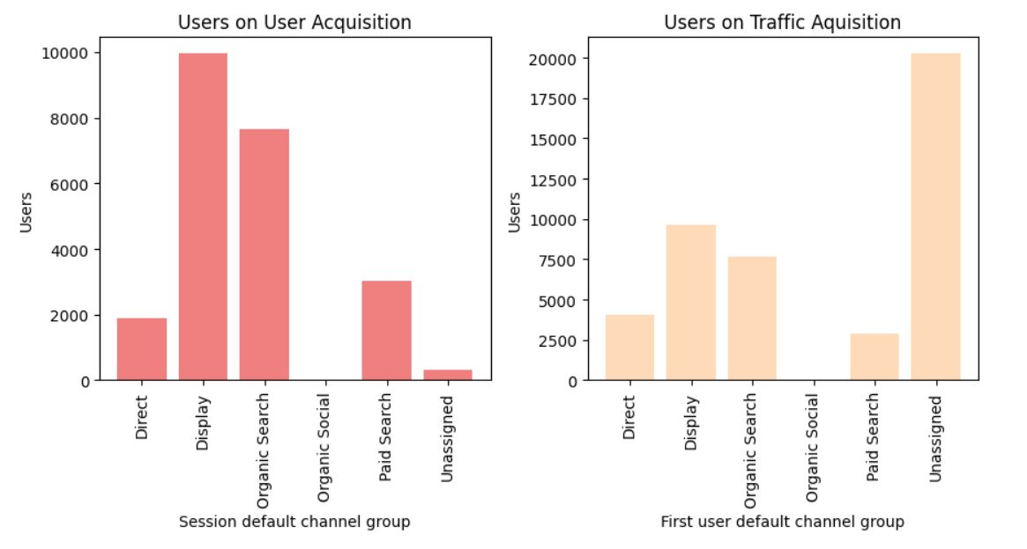
Users and Traffic Acquisition
In user acquisition, a more number of new user comes in display channel and organic search.
In organic search engagement was higher than display.
In traffic acquisition, highest number users comes in unassigned.
But user acquisition has 44.07% and traffic acquisition has 43.42% of session engagement, it was higher than display and unassigned, so organic search has performed better.

Slide 3
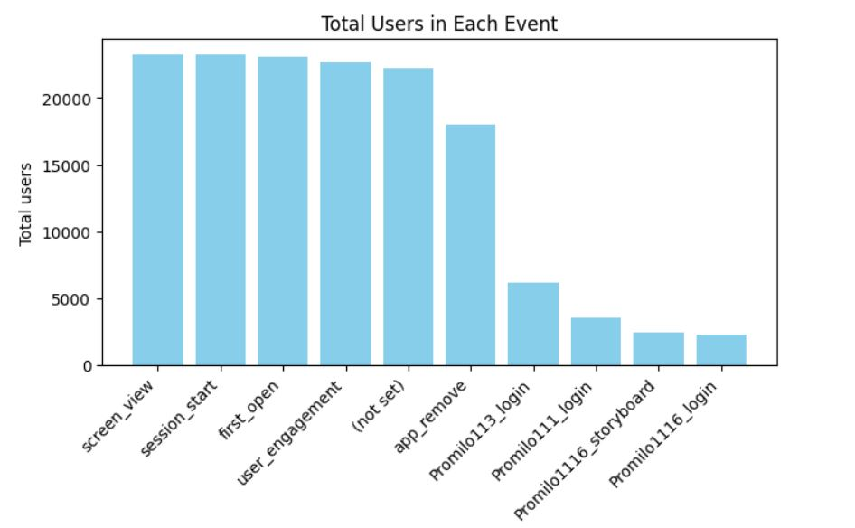
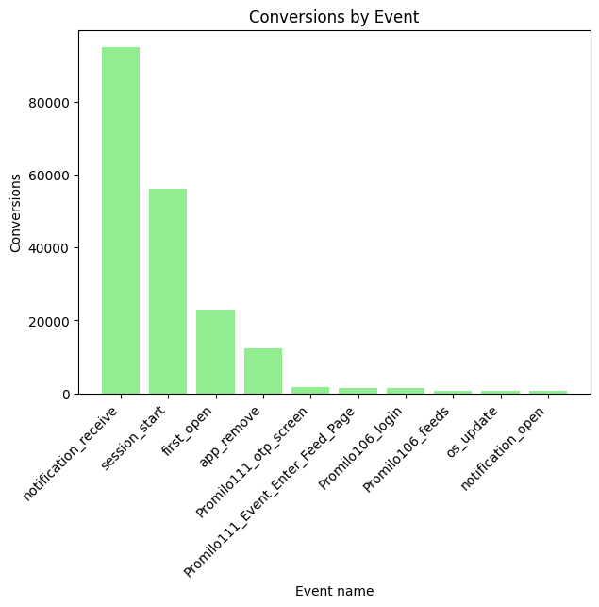
Event and Conversions Report
Total users in all event 2.21L.
The major users are comes in screen view, session start, first open and user engagement.
The total conversions of all event 1.93L.
In notification receive event only took 48% of conversions were done.

Slide 4
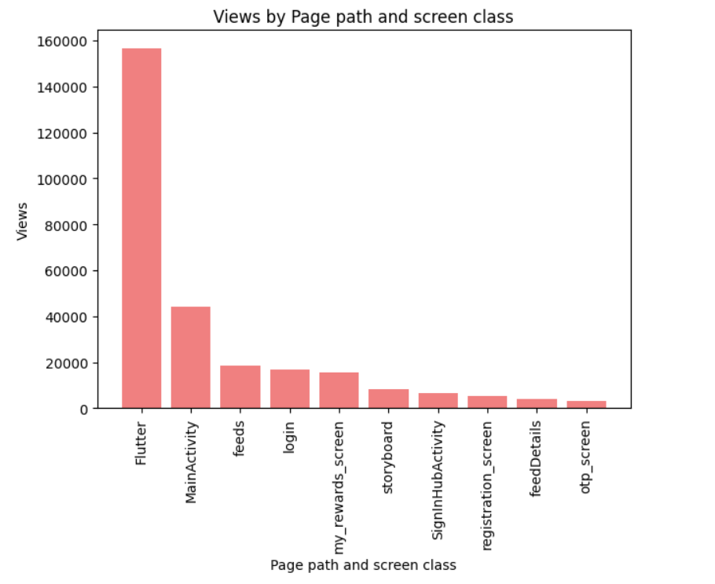
Pages & Screen Report
Overall 2.97L views were gone in Page and screen class .
Highest views of screen class is ‘flutter’ 1.54L.
Page and screen class conversions of ‘Not set’ category was 88k, it took 98% of the total.
But it views was 0.
‘Login’ is the second highest conversion and followed by ‘flutter’.

Slide 5
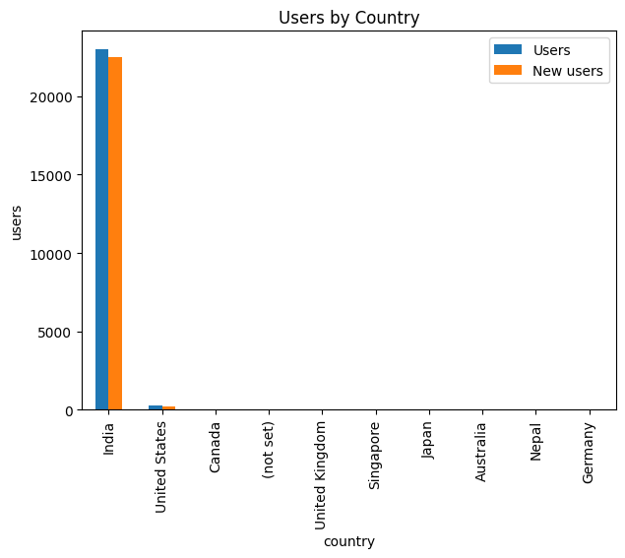
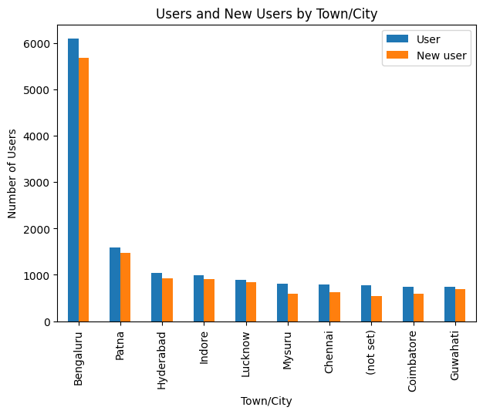
Country and City-wise Report
In country wise analysis india has highest number of users and new users.
Conversions also india took highest rate 99%.
In india, bangaluru city most number of users were came.
City wise conversions Bangaluru is lead 62k followed by second place Hyderabad 32k.

Slide 6
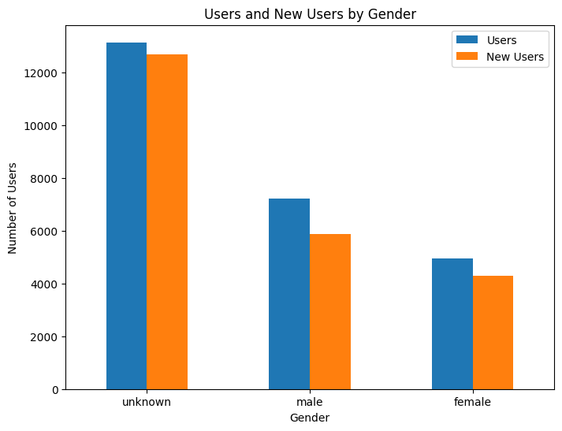
Gender Report
In gender analysis, unknown was highest number of users and new user, 57% of users in unknown.
Second highest is male and followed by female.
Conversions of gender, unknown was 48%, male is 34% and female is 18%.

Slide 7
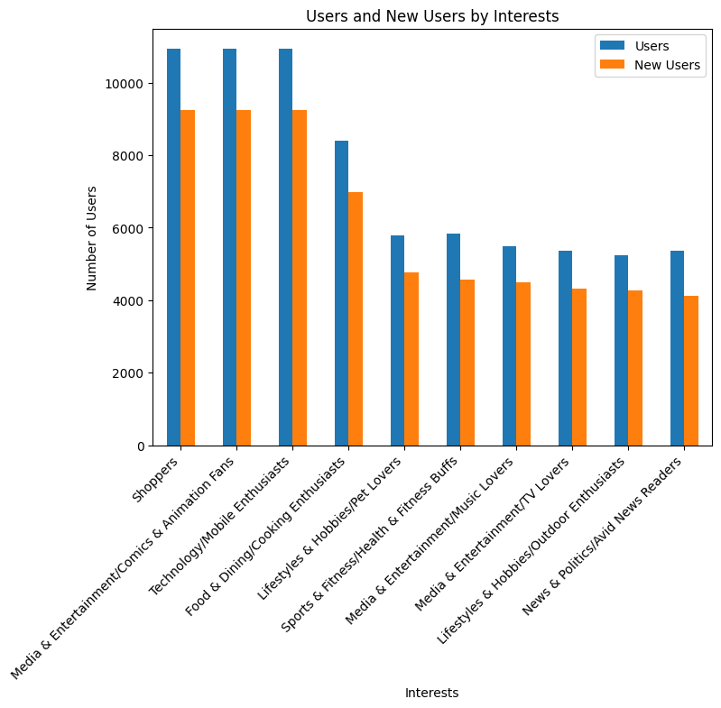
Users Interest
In interest shoppers, Media & Entertainment/Comics & Animation Fans and Technology/Mobile Enthusiasts are have 10k users and 9k new users.
In conversions also shoppers, Media & Entertainment/Comics & Animation Fans and Technology/Mobile Enthusiasts are reached 8k.

Slide 8
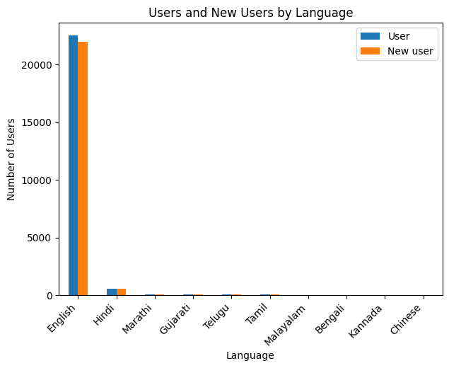
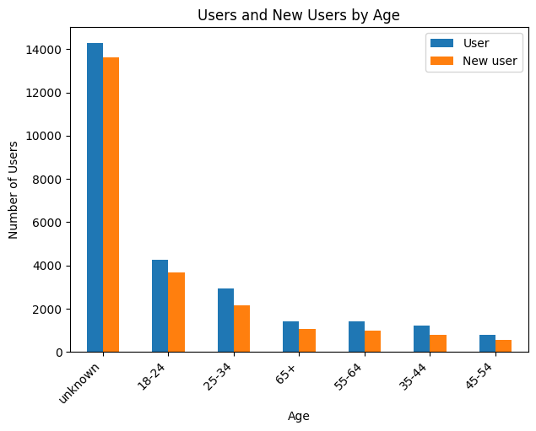
User by Language and Age
In language, english is the highest number of users, session engagement and conversion were done.
Hindi is second highest in overall.
In age group, unknown is highest number of users and followed by 18-24 is second place.
Unknown also have highest conversions rate 51% and 18-24 age group peoples conversions rate is 27%.

Slide 9
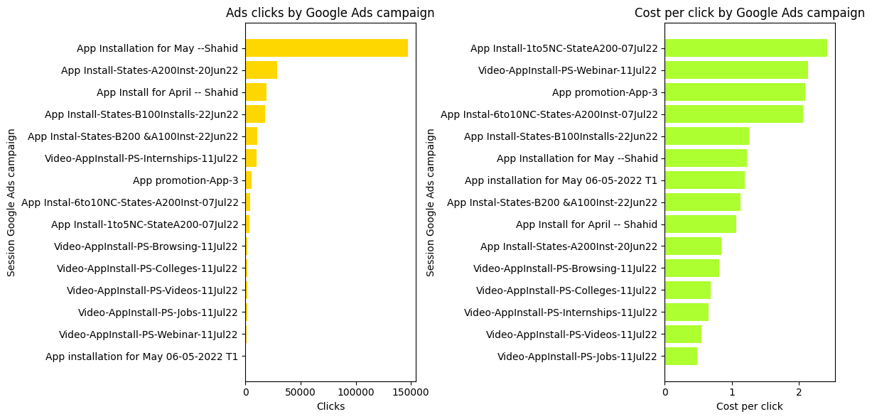
Google Ads Report
Most expensive google ads campaign was ‘App Installation for May –Shahid’, it was the highest clicks 1.47L.
Lowest click was ‘App installation for May 06-05-2022 T1’ and it’s conversion also low.
Highest cost of per click is ‘App Install-1to5NC-StateA200-07Jul22’ and lowest cost of per click is ‘Video-AppInstall-PS-Jobs-11Jul22’, but cost per conversions was high 15.09.

Slide 10
Recommendations
Enhancing Organic Search strategies can get high conversion rate.
Screen view event should be checked because it has high number of events but low users count. So it can attract more users by changing its strategy.
By optimizing the flutter content you can attract more users and by considering the category with low views you can improve the conversion.
India is our priority, to target more cities like 2 tier city to get more conversions and investigate the reason for low conversions cities to improve conversions.
In gender, unknown category as consider as both gender. Run some campaign for specific for female to attractive conversion.

Slide 11
Recommendations
In user interest, run more campaign related to Shoppers Media & Entertainment/Comics & Animation Fans Technology/Mobile Enthusiasts were can increase conversion rate, more attention to other category for session engagement.
In Age, unknown age have high values, so giving more option for age selection to identify the targeted audience. 18-24 age group people is second highest so give more focus that audience for more conversions.
In google ads, increase budget of this campaign ‘Video-AppInstall-PS-Jobs-11Jul22’ can improve performance.
Lowest performance was ‘App promotion-App-3’ investigate the mistake and enhance the campaign to performance improvement.

